Slide 1
Ball Collision Project Midpoint
By: Jeremiah Hsieh

Slide 2
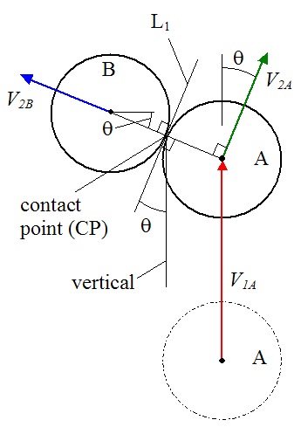
Overview
Perfectly elastic ball collision physics (2d/3d)
Current status: 2d perfect elastic

Slide 3
Project Motivation
Computer simulation of reality
Extrapolate to things like pong
Relevant due to drawing objects

Slide 4
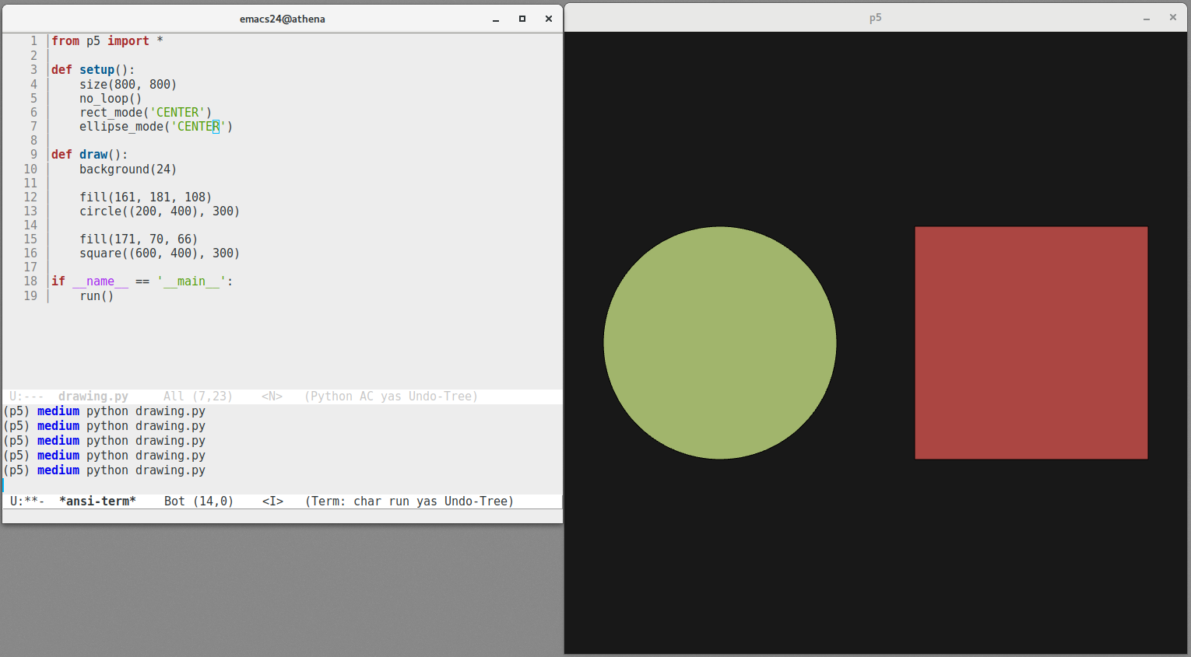
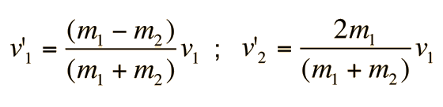
References
Newtonian physics
2d: manual render/equations and/or libraries
3d: unity/blender
https://en.wikipedia.org/wiki/Elastic_collision

Slide 5
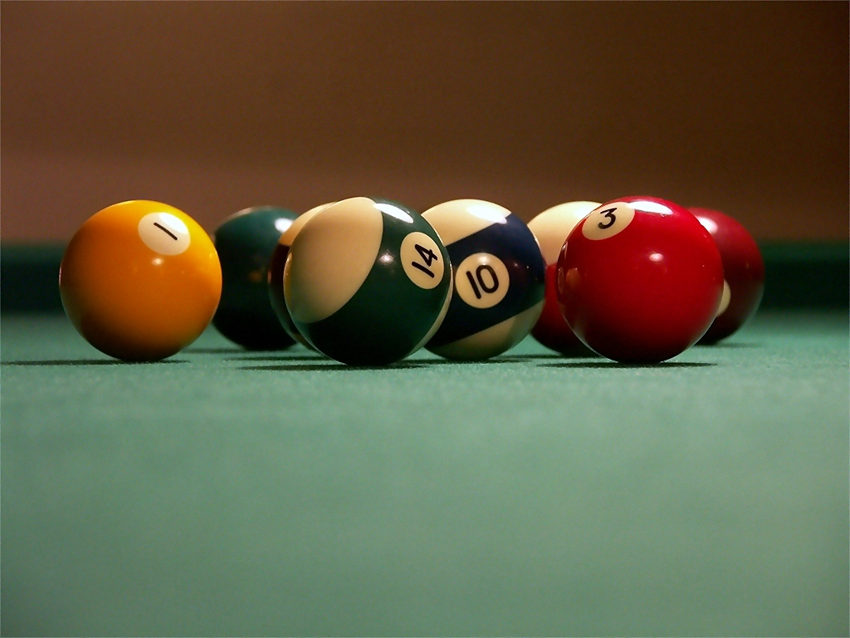
Define the Problem
Using computer to calculate object pathing/collision
Simple object (sphere, line) for relatively constant reactions
Various additional parameters possible
rebound force
“stickiness”
Gravity

Slide 6


Survey
Various libraries
Pybullet
Pyopengl
Unity

Slide 7
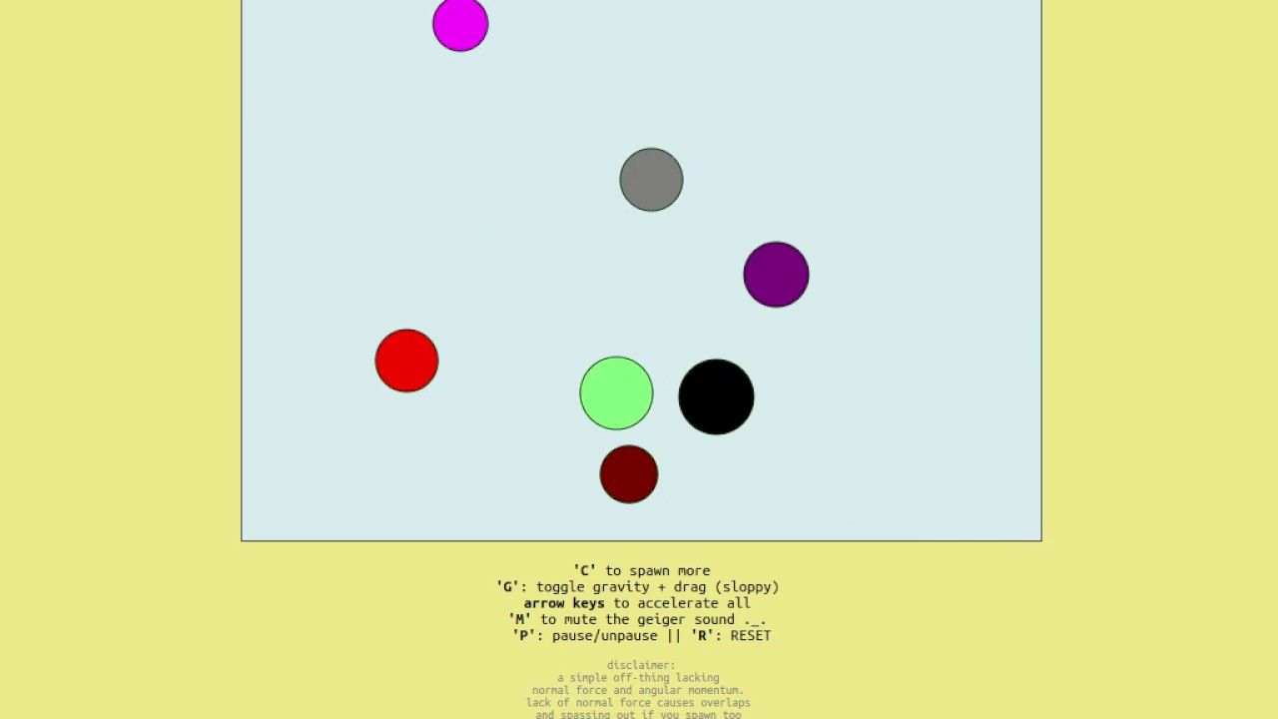
Main Idea
3 main parts
UI for inputting values (# balls, speed, etc.)
ball behavior physics calculator (using above values)
Graphics renderer (using above values)

Slide 8
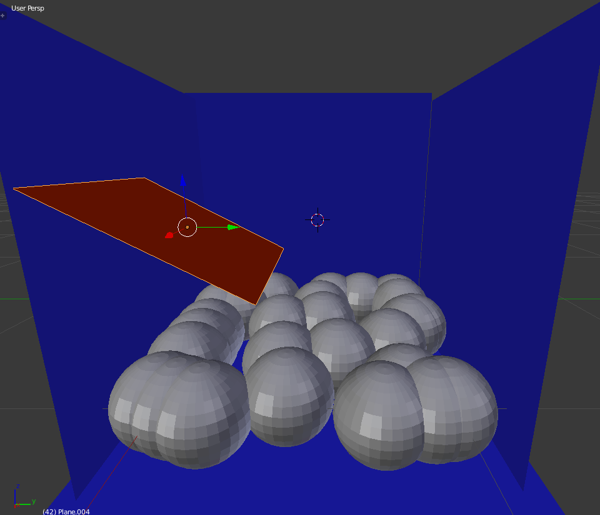
Expected Outcome
Make program to simulate 2d and/or 3d ball collisions with various parameters
# of balls
Size
Elasticity
air viscosity
Gravity

Slide 9
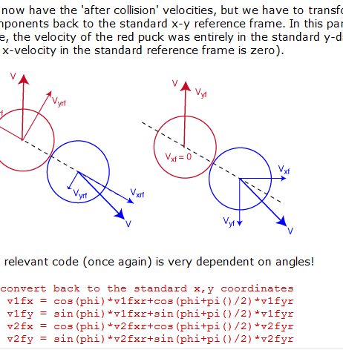
Plan and Milestone
Order of ease in implementation
UI
Physics calculator
Rendering images
2d seems simpler, 3d if needed
First 2 parts by midpoint

Slide 10
Summary
Learn how to:
render objects
edge collision detection
physics emulation

